Slide 1

Climate Change Presentation
Myles Biss

Slide 2
Agenda
Raw Data
EDA Process
Data Cleaning
Analysis
Drawing Conclusions
Thank You!
Citations

Slide 3
Raw Data Source
https://climateactiontracker.org/
Sourced Data from UN
https://www.naturalearthdata.com/downloads/10m-cultural-vectors/
Admin 0 – Countries
https://climate.nasa.gov/vital-signs/global-temperature/?intent=121
Global Temperature Average from Nasa

Slide 4
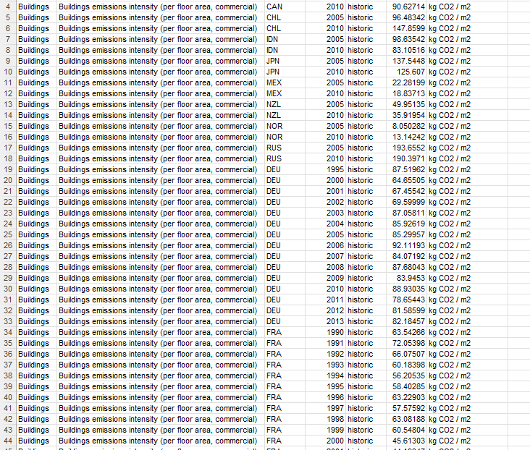
Raw Data

Slide 5
EDA Process & Data Cleaning
Explanation in Jupyter Notebook
France -99
Electricity only

Slide 6
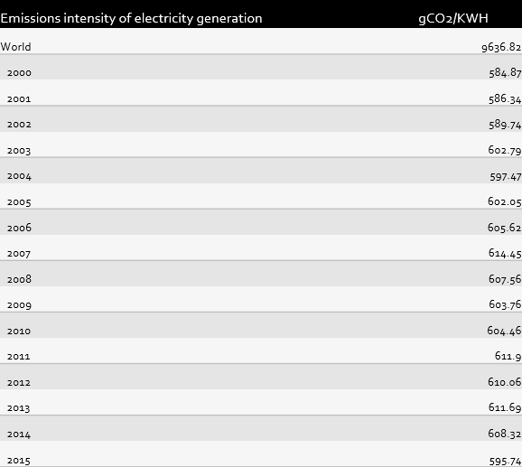
How Data Works
Only Electricity data will be analyzed
Values are averages between countries
Different Sectors
PowerBI

Slide 7
Context: What is Climate Change?
Climate change is a long-term shift in global temperatures and weather patterns
Hurricanes, Droughts
Sea levels rising
Human behavior is the main driving force behind climate change
The shift in global temperature increases started in the 1800s during the dawn of the industrial revolution
Which is when humans began to use fossil fuels
Such as Coal

Slide 8
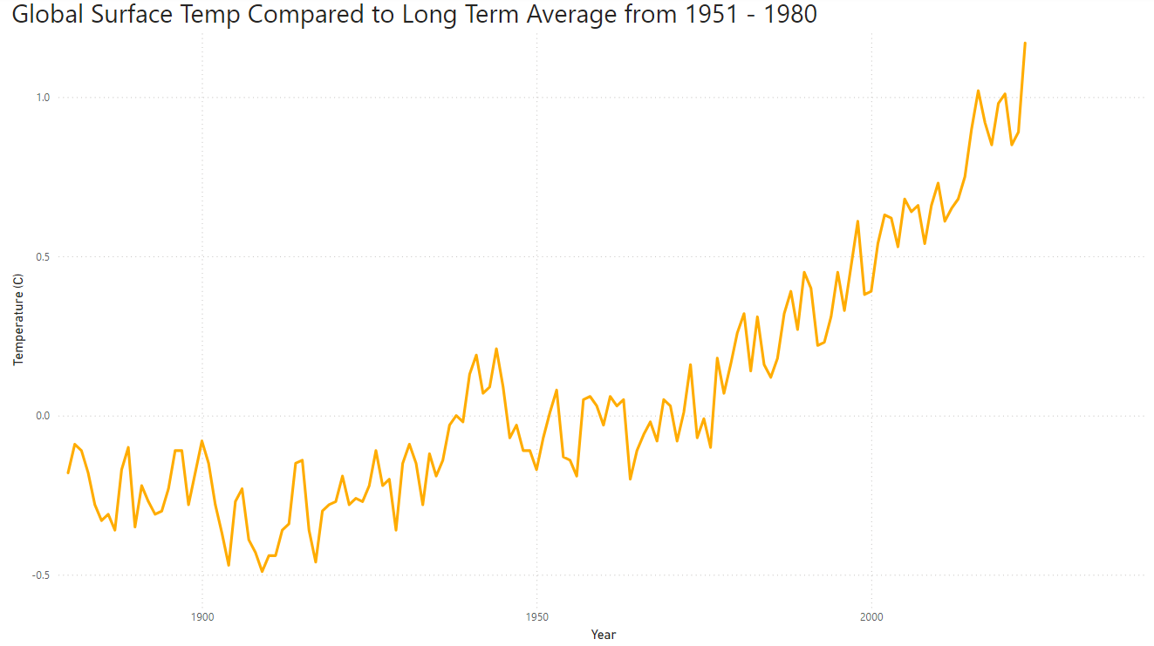
Global Temperature Increases

Slide 9
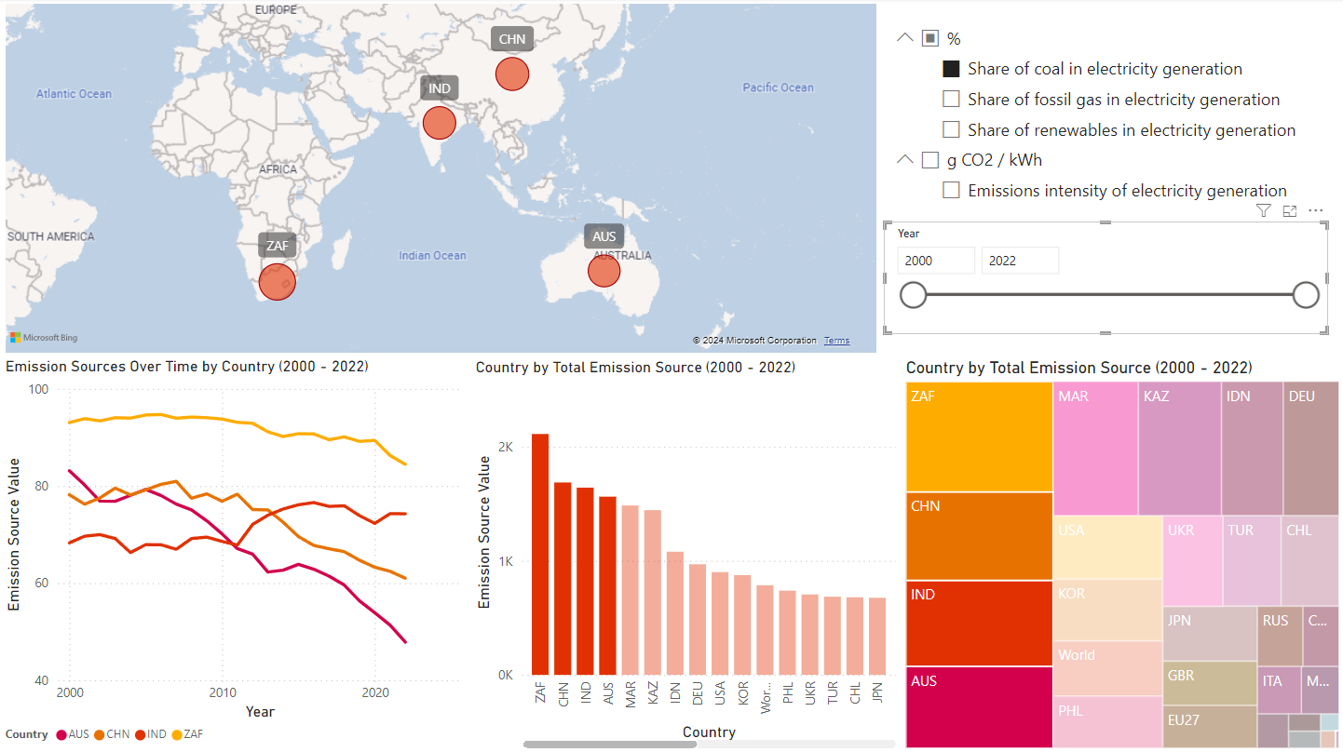
Coal % Usage

Slide 10
Is Coal Power bad?
One of the highest gCO2/KWH Power Sources
Brings electricity to those who don’t have it
Cheaper than other power sources

Slide 11
Other Options?
Developing Nations → Natural Gas
Developed Nations → Nuclear Power
Hydro, Solar, and Wind have more glaring issues

Slide 12
Conclusions
Climate Change is a Global Problem
Coal power should be phased out
Developing Nations use lots of Coal
Coal power plants are cheap
They have more pressing matters
Move to different power sources
Like Nuclear, Natural Gas, or Hydro
Coal power is Inefficient (gCO2/KWH)

Slide 13
Thank You

Slide 14
Sources
Ritchie, H., Rosado, P., & Roser, M. (2020, May 11). CO₂ and greenhouse gas emissions. Our World in Data. https://ourworldindata.org/co2-and-greenhouse-gas-emissions
United Nations Framework Convention on Climate Change. (n.d.). The Paris Agreement. UNFCCC. Retrieved November 25, 2024, from https://unfccc.int/process-and-meetings/the-paris-agreement
National Aeronautics and Space Administration. (n.d.). Global temperature. Climate Change: Vital Signs of the Planet. Retrieved November 25, 2024, from https://climate.nasa.gov/vital-signs/global-temperature/?intent=121
National Aeronautics and Space Administration. (n.d.). The effects of climate change. NASA Science. Retrieved November 25, 2024, from https://science.nasa.gov/climate-change/effects/
United Nations. (n.d.). What is climate change? United Nations. Retrieved November 25, 2024, from https://www.un.org/en/climatechange/what-is-climate-change

